Slide 1
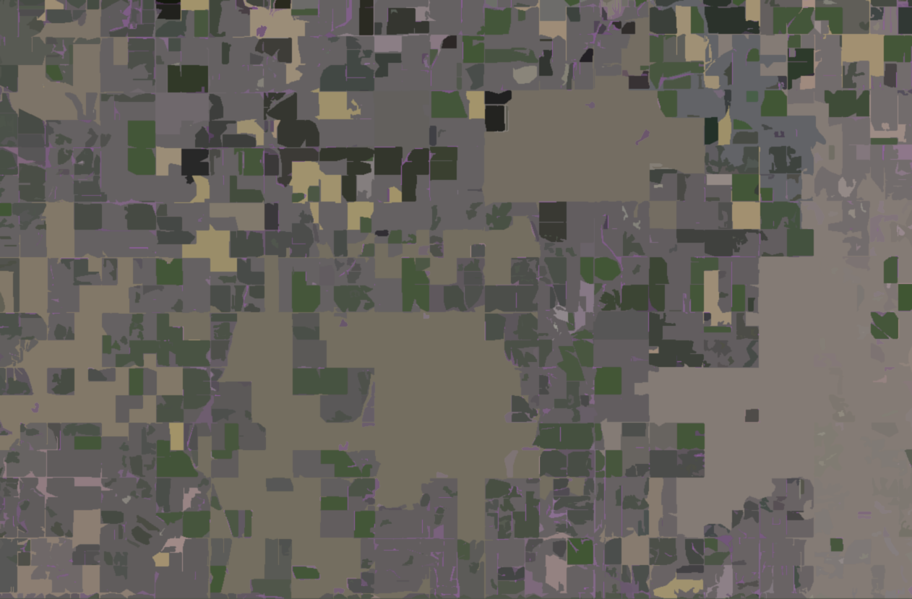

Applying Non-Survey Data and Machine Learning Techniques to Address Nonresponse in an Agricultural Area Frame Survey
Arthur Rosales, Tara Murphy, Luca Sartore, Jake Abernethy, Robert Emmet, Linda J. Young
The findings and conclusions in this presentation are those of the authors and should not be construed to represent any official USDA or U.S. Government determination or policy.
Notes:
Hi, my name is Darcy Miller. I’m here to present “Applying Non-Survey Data and Machine Learning Techniques to Address Nonresponse in an Agricultural Area Frame Survey.
You’ll notice that my name is not on this slide with Arthur Rosales, Tara Murphy, Luca Sartore, Jake Abernethy, Robert Emmet, and Linda J. Young. I work with all of these great researchers on a broader team developing and updating automated imputation techniques at the National Agricultural Statistics Service. Due to budget constraints and JSM speaker participation rules, I will be presenting the fantastic work my colleagues have done. But don’t worry, most of them are here at the conference to answer your detailed questions!
With that let’s get the show started.

Slide 2

June Area Survey (JAS)
NASS’s largest annual survey
Historically conducted via in-person interviews
Provides annual measure for number of farms and land in farms in U.S.
Produces direct estimate of large crop commodities such as corn, soybeans, and wheat, among others
Measures the incompleteness of the NASS List Frame
Notes:
The National Agricultural Statistics Service, or NASS, is the statistical arm of the USDA. One of the hundreds of surveys we conduct is the June Area Survey, or JAS.
The JAS is NASS’s largest annual survey in terms of scope and cost, and it historically has relied on in-person interviewing.
It is conducted in June has multiple important uses including: an annual measure for number of farms and land in farms in the U.S., direct estimates of large crop commodities, and measuring the incompleteness of the NASS List Frame.

Slide 3
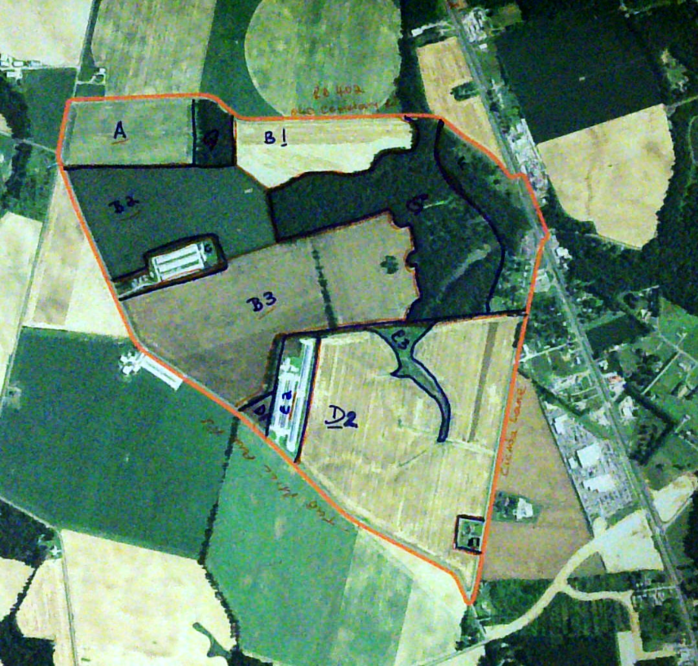
June Area Survey (JAS)
Based on an area frame with complete coverage of the contiguous U.S.
Segments of land are sampled and remain in survey for five years
Sampled segments are divided into tracts representing unique land operating arrangements
Notes:
The JAS is an area frame survey, where the sampled areas are composed of segments of land.
Each newly sampled segment is in-sample for 5 years. And each year about 20% of the sample segments rotate out and are replaced with new sampled segments.
Each sampled segment is also further divided into tracts, representing unique operating arrangements (which may or may not be growing multiple commodities).

Slide 4
June Area Survey (JAS): Nonresponse
In the case of refusal or inaccessibility of survey targets, missing data must be imputed in the JAS
Traditional methods draw from direct observation, previously reported data (PRD), and local context
This imputation is handled case-by-case, by hand
JAS tracts are unique survey targets: land areas as opposed to farm operations
  Difficult to link to other farm information collected by NASS
Notes:
Nonresponse in the June Area Survey is particularly challenging, because the survey design requires complete data for all samples. Therefore, all tracts with nonresponse need to be imputed
Historically, imputation has been a manual process, drawing from a variety of auxiliary information sources, with regional approaches. The in-person interview data collection method allows for some field observation of tracts, and this along with previously reported data or (PRD) can help complete the picture.
Even using PRD is a challenge since specific tracts of land do not typically match in a 1-to-1 way with list frame records, making it difficult to match the auxiliary information from other NASS surveys.

Slide 5
Imputation Rates Have Increased
Notes:
Not only is imputation challenging, but it is playing an increasingly prominent role as a source of data for the JAS.
As of COVID 19, imputation has increased. Even though a wide variety of data collection methods (including all telephone, more computerized mobile instruments, a blend of telephone and in-person interviews), have been used in the 2021, 2022, and 2023 survey cycles to mitigate the nonresponse, the higher imputation rate has remained constant.

Slide 6
Nonresponse Impacts Data Quality
Notes:
This higher nonresponse poses a problem.
In this graph, you can see accuracy of reported data in blue versus imputed data in grey for classifying corn for a tract of land. Data quality for manually imputed records has historically been lower than for full reports.

Slide 7
Automatic Imputation
Replacing the manual imputation with automated process can:
  Save time and money
  Standardize methods
  Allow for measuring error
Challenge: Shortage of usable ancillary information from other NASS surveys
Can non-survey data sources be useful to support a new automatic imputation system in the JAS?
Notes:
In the past, imputation has been a costly manual process. Replacing this process with a statistically defensible automated process will not only save time and money but also standardize methods used and allow for measuring error and imputation variance.
A challenge we have had is that information from other NASS surveys has limited benefit due to the challenge to match records to tracts, remember, these do not tend to be 1-1 matches.
But, can non-survey data sources be useful here?

Slide 8
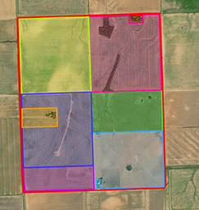
Digital Tract Boundaries
Beginning 2021, all in-sample tract boundaries have been digitized
Geospatially-referenced record of tracts
Allows JAS data to be linked to other data for imputation and quality assessment
Notes:
Well, new data availability is bringing NASS closer to automating and standardizing imputation for the JAS tracts utilizing non-survey data
The key new source of information to advancing JAS imputation is the digitized tract dataset.
In 2021, all JAS in-sample tract boundaries were digitized. This provides a geospatially referenced record of the tract.
This in turn means that the tract may be spatially linked to other useful sources of information, such as administrative records that have been tied to spatial boundaries or remotely sensed data, such as satellite data.

Slide 9
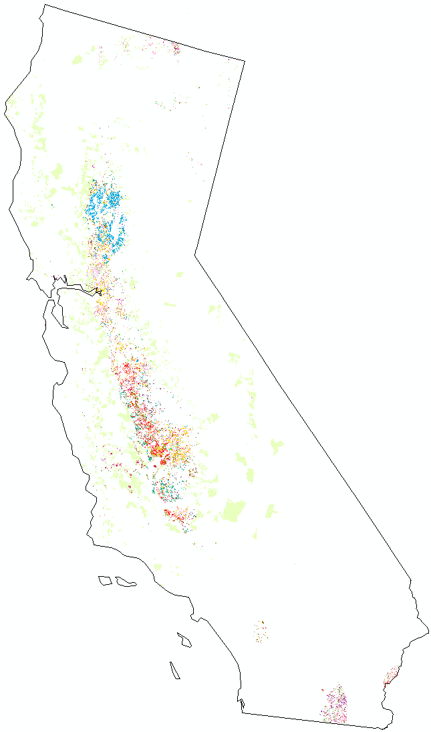
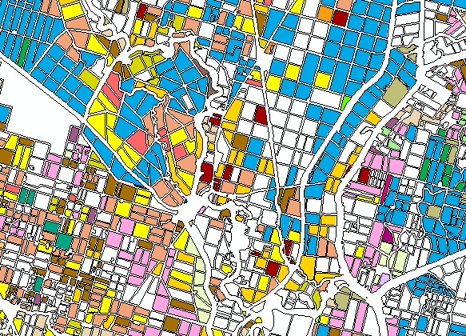
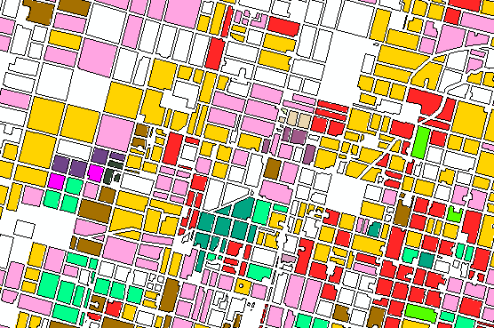
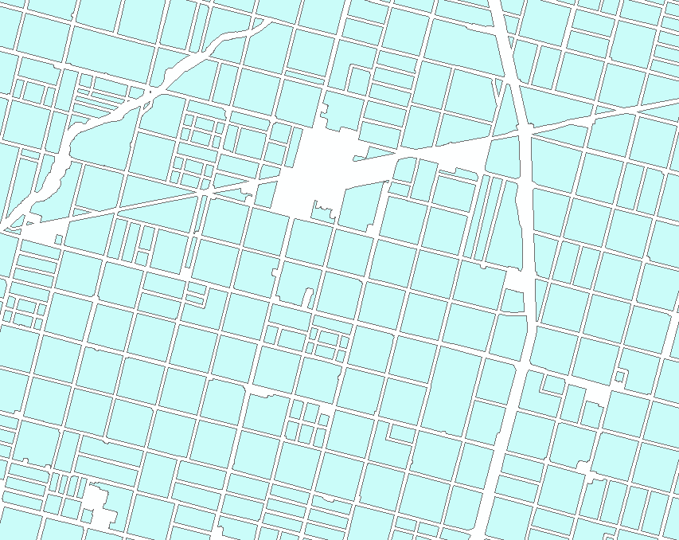

Administrative Data as Ground Truth:
Farm Service Agency (FSA)
9
FSA Crop Acreage Reports
Farmer reported data specifying crop type and location
Linked to the land using Common Land Units (CLUs) polygons
Notes:
A key piece of administrative data is Farm Service Agency (FSA) sign up data. When a farmer wishes to participate in a USDA program, they must register with the FSA using the 578-form. This report must happen every crop year, and contains information about the intended cropping practices including crop-type and planted acreage.
Participation in FSA programs varies by crops, but it is very prevalent for major commodities such as corn and soybeans.
Given the need for proper reporting in order participate in USDA programs, NASS regards this FSA data to be a gold standard of data quality. Therefore, it has excellent applications as a form of ground truth.
The 578 sign-up data is linked to geospatial boundaries called Common Land Units, or CLUs which can be further linked to the JAS digitized tracts.
Great! So let’s impute the FSA Data. Well, even this as ground truth has some challenges. Timing of the FSA data availability is a big issue because due dates for participation are often after June, which means this data cannot be used directly during the survey data collection period.
However, it is a powerful tool in post-data collection data quality assessment.

Slide 10
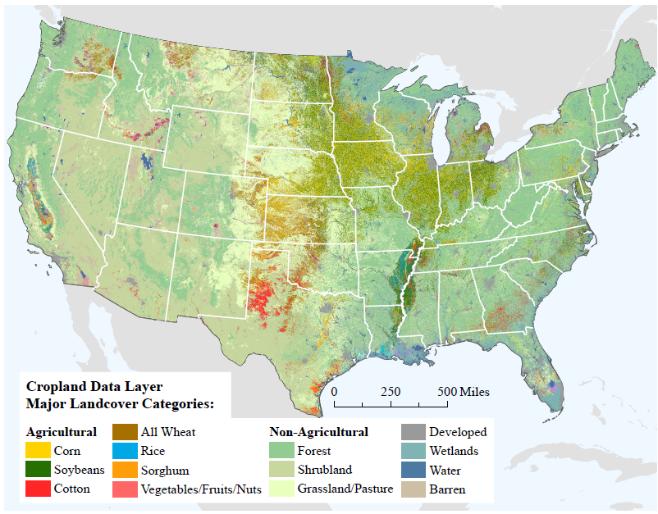
NASS Cropland Data Layer (CDL)
Annually produced, georeferenced, 30m, crop-specific land cover dataset
Captures planted acres
Freely available to the public
Provides information for over 100 crops
National scale (2008 – 2023)
Only complete at end of growing season
CroplandCROS: https://croplandcros.scinet.usda.gov/
Notes:
Another geospatial data source that could be linked to the JAS digitized tracts is landcover information contained in the NASS Cropland Data Layer (or CDL)
The CDL is an annually produced “raster” dataset, where each of its 30m x 30m pixels is classified as some landcover type such as corn (yellow) soybeans (green), or other non-cropland types such as forest or shrubland.
It captures planted acres of over 100 crops and is freely available to the public for years 2003 to 2023.
The CDL has excellent applications in assessing locations and acreages of crops, but it is only available after the JAS data collection as well, since it is created based on a full year’s worth of satellite imagery of the landcover.

Slide 11

Predictive Cropland Data Layer (PCDL):
Modeling Crop Rotations at the Pixel Level
Past CDLs and FSA Crop Reporting data
February Prediction
Notes:
In order to make CDL data useful for the JAS, NASS developed methods to predict the CDL data before the season begins.
We call the output of this effort the Predictive Cropland Data Layer, or PCDL.
Generally speaking, the PCDL approach is to turn rotational patterns observed in historical CDLs and FSA Crop Reporting Data to make probabilistic predictions about the current growing season.

Slide 12
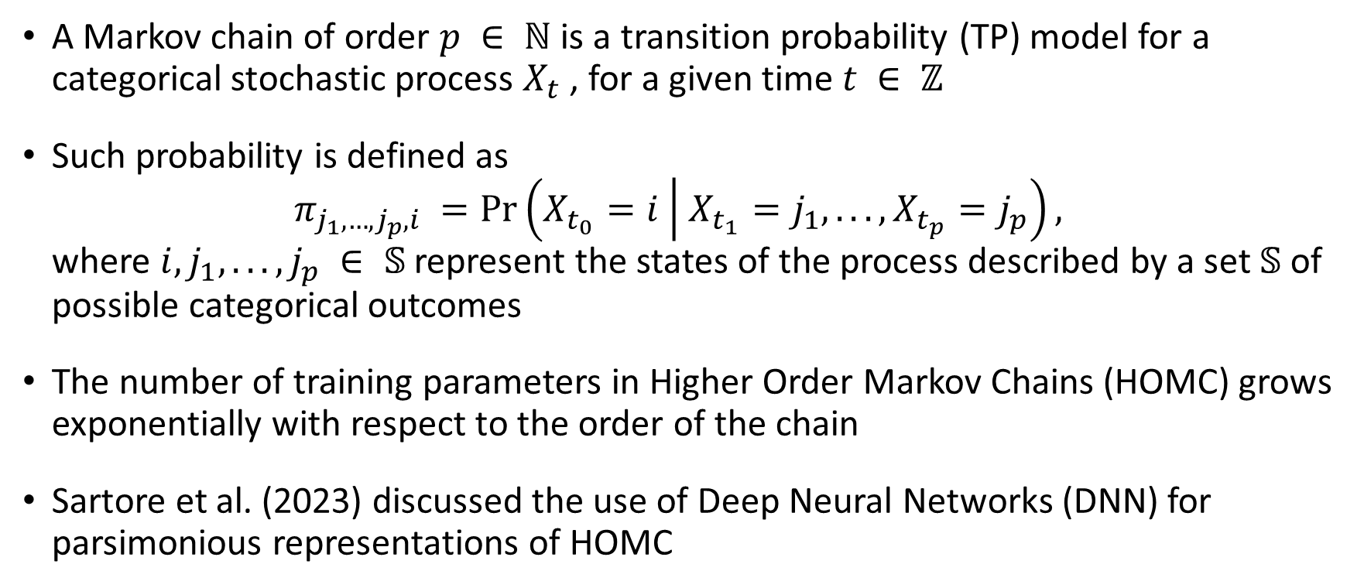
PCDL Model Details
A Markov chain of order $p ∈ ℕ$is a transition probability (TP) model for a categorical stochastic process $X_{t}$ , for a given time $t ∈ ℤ$
Such probability is defined as
$π_{j_{1},…, j_{p},i} =\operatorname{Pr}\left(X_{t_{0}}=i | X_{t_{1}}=j_{1}, . . . , X_{t_{p}}=j_{p}\right),$
where $i, j_{1}, . . . , j_{p} ∈ 𝕊$ represent the states of the process described by a set $𝕊$ of possible categorical outcomes
The number of training parameters in Higher Order Markov Chains (HOMC) grows exponentially with respect to the order of the chain
Sartore et al. (2023) discussed the use of Deep Neural Networks (DNN) for parsimonious representations of HOMC
Notes:
The model for the PCDL is based on the Markov chains that account for the observed crops in the past p (5) years.
In this approach, predictions are made at the pixel level.
Markov chains are traditionally modelled with transition probabilities (such as those provided in this formula). However, the number of parameters required to model longer sequences of data increases exponentially. Given that predictions are made at the pixel level, this is an issue here. Therefore, Deep Neural Networks were explored to reduce the number of parameters without sacrificing the predictive accuracy of the model.

Slide 13
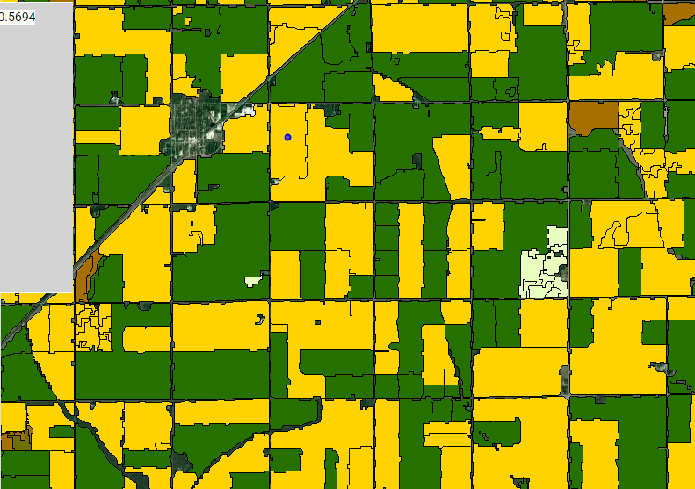
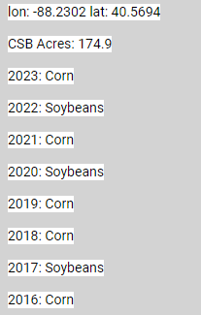
Crop Sequence Boundaries (CSBs):
Synthetic Crop Fields
Automatically delineated fields
Synthetic representation of agricultural fields, their acreage, and crop rotation history
Derived from historical CDLs
Each CSB (field) has tabular attributes, including 8 years of crop planting history
Compared to pixel land cover data, field polygons represent significant data reduction while containing rich attribute tables
Notes:
Another source of Geospatial data that can be tied to the JAS digitized tracts are Crop Sequence Boundaries, or CSBs
CSBs are Vector-based geospatial data developed by NASS and the USDA’s Economic Research Service that are freely available to the public.
They are fully synthetic representation of agricultural fields, their acreage, and crop rotation history and are derived from historical CDLs and road/rail networks over a set timeframe
Unlike pixels, which are each 30mx30m (about the size of a baseball diamond), CSBs are polygons the size of fields themselves. This format has two benefits in terms of predictive modeling:
1) as opposed to billions of pixels, there are only millions of polygons: this represents a significant data reduction
2) shapefile polygons can easily contain rich attribute tables, providing a diverse set covariates to use for predictions

Slide 14
Predicting CSB-Level Crops: PCSB
Each CSB is a prediction target
  8 years of crop planting history and other covariates used to predict current crop type (Corn, Soybean, Other)
LightGBM machine learning model
  Gradient boosting tends to do well on tabular data
  LightGBM easily handles categorical features
CSB-level predictions (PCSBs) spatially joined to digital tract boundaries, summarized
Notes:
Researchers at NASS developed an approach to predicting crop types at the CSB level using 8 years of planting history.
Ultimately, a LightGBM machine learning model was selected for this process due to historical performance, as well as the fact that gradient boosting algorithms tend to perform well for tabular data. Additionally, it is easy for LightGBM models to handle the categorical features of the CSB (crop type)
Once predictions are made, the CSB level predictions, or PCSBs can be spatially joined to the JAS digitized tracts for the purpose of imputation

Slide 15
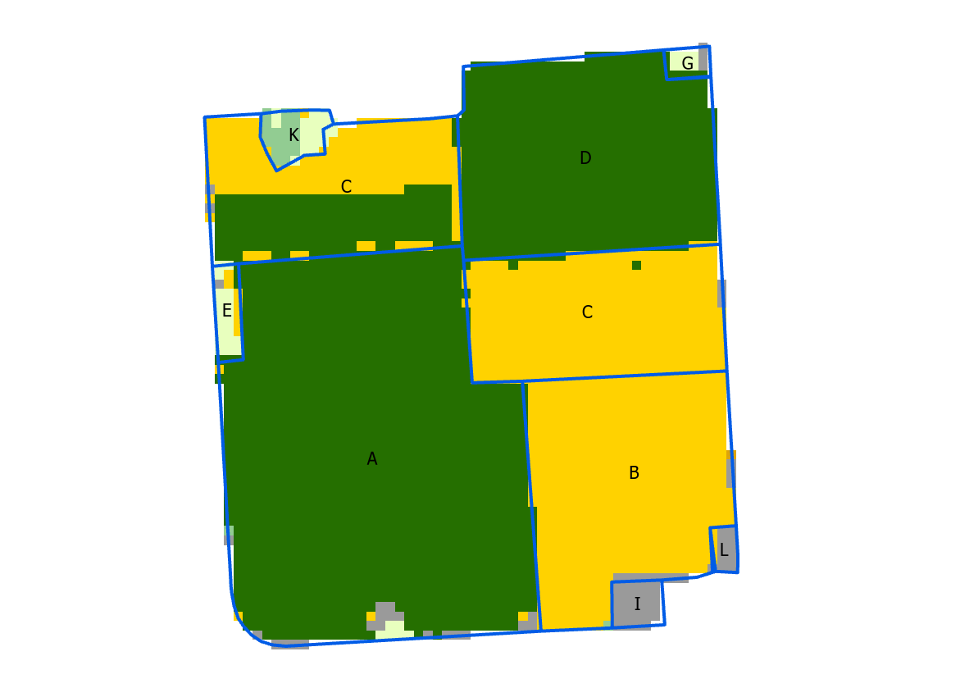
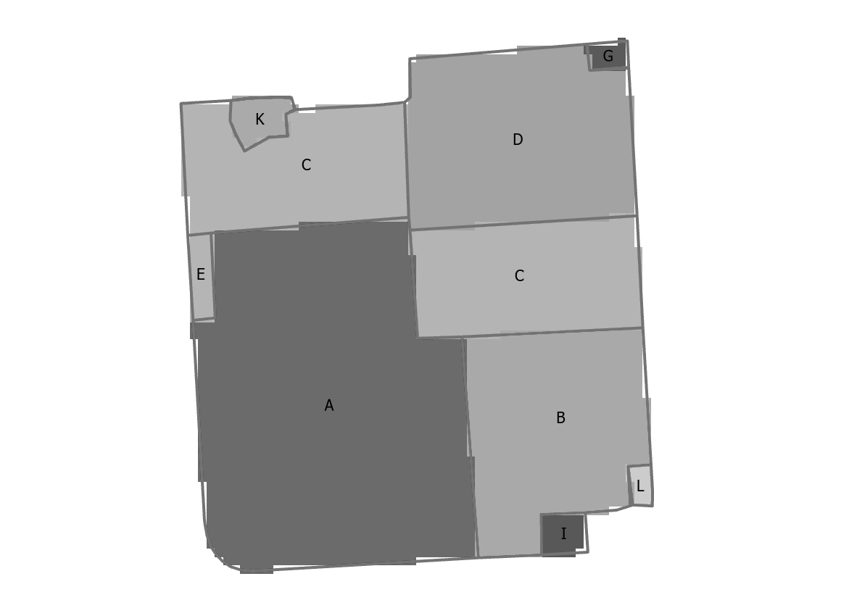
Two Sources, Similar Performance
PCDL Predictions
Summarized for Each Tract
PCSB Predictions
Summarized for Each Tract
Summarizing both predictions at the JAS tract level demonstrated similar performance overall performance, but different predictions exist for many tracts.
How to select predictions?
How to select tracts?
Notes:
So, we’ve looked at two ways to make field-level predictions of crop types and acreages, the PCDL and the PCSB, each of which can be linked to the JAS target records spatially through use of digitized tracts.
We summarized both types of predictions at the JAS tract level and they demonstrated similar overall performance, but the predictions were different between the two methods for many individual tracts.
So, how should we select predictions for the tracts? And, which tracts have a predictions reliable enough to utilize those predictions as imputed values?

Slide 16
Filtering Tracts for Imputation
PCDL Predictions
Summarized for Each Tract
PCSB Predicitons
Summarized for Each Tract
Model Agreement
as a
Measure of Reliability
If agreement between two sources is high, the tract is imputed with the average of PCDL and PCSB predictions
SEGMENT-TR | PCDL_Corn | PCDL_Soybean | PCDL_Non_Ag
151004-A | 8.2 | 247.3 | 9.6
151004-B | 102.1 | 1.01 | 5.4
151004-C | 116.9 | 30.2 | 4.7
151004-D | 0 | 111.0 | 3.3
151004-E | 3.2 | 1.2 | 8
151004-G | 0 | 4.0 | 4.5
SEGMENT-TR | CORN | SOYBEANS | NO_CSB_AG
151004-A | 7.0 | 246.7 | 10.4
151004-B | 98.9 | 1.0 | 8.4
151004-C | 120.9 | 26.4 | 6.6
151004-D | 67.4 | 43.2 | 3.3
151004-E | 2.1 | 3.2 | 7.7
151004-G | 0.5 | 0.3 | 2.2
Notes:
Though each model has strengths and weaknesses, we discovered that a high level of agreement between the two models could be useful as an indicator of reliability of predictions themselves.
In the tables, you see a snippets of analysis done for Corn, Soybean, and Non-Ag landcover for 2022.
Essentially, overall analysis showed that if the predicted crop types and acreages were similar between the PCDL and PCSB predictions, then those predictions were more reliable. Then, the tract should be imputed and the average of the two predictions is used.

Slide 17
Research Questions
A retrospective study based on historical survey data, predictions, and FSA data was conducted to address the following questions:
Q1: Could model agreement between PCDL and PCSB tract predictions be useful to select tracts for automatic imputation?
Q2: If the automatically imputed corn acreage was used, are the resulting state estimates affected?
Q3: Using FSA data as a gold standard to assess, does using automatically imputed values impact tract-level corn acreage accuracy?
Notes:
With an automatic imputation method selected, averaging the PCDL and PCSB predictions, a retrospective study was conducted using historical data.
We wanted to answer the 3 questions you see here:
Could model agreement between PCDL and PCSB tract predictions be useful to select tracts for automatic imputation?
If the automatically imputed corn acreage was used, are the resulting state estimates affected?
Using FSA data as a gold standard to assess, does using automatically imputed values impact tract level corn acreage accuracy?

Slide 18
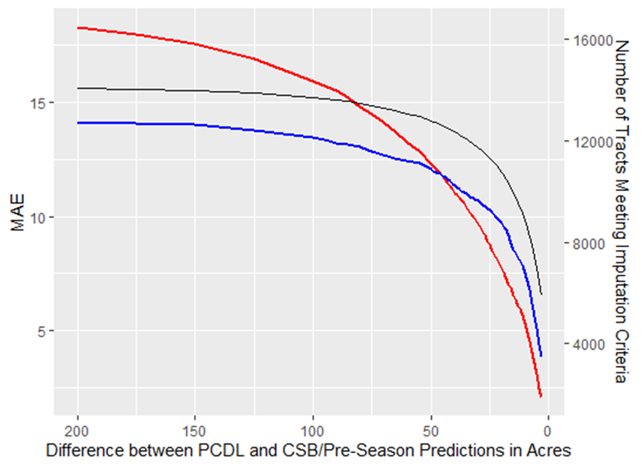
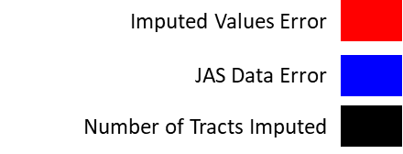
Q1: Model Agreement Optimization
Historic simulations discovered that as agreement between these predictions increased, predictive error decreased
Model agreement threshold:
  Maximize the number of tracts that could reliably be predicted
  Minimize error to acceptable levels
Notes:
This graph demonstrates how we used model agreement between the PCDL and the PCSB to set an optimal threshold for tracts to be imputed by maximizing the number of tracts that can be reliably predicted while minimizing error to acceptable levels.
The red and blue lines on the graph represent the Mean Absolute Error , or (MAE) relative to ground truth for automatic imputation values and JAS reported data, respectively.
As the difference between the PCDL and PCSB predictions decreases (moving right across the x axis), the Mean Absolute Error of both the imputed values and JAS reported data decreases (as seen in the y axis labels on the left).
The zone of acceptability is where the red line is below the blue line, that is: where the automatically imputed values have lower error than the survey reports.
The tracts of land in the zone of acceptability would be pushed forward for automatic imputation if they contain missing data
The trade-off is in the number of tracts that can be imputed, represented by the black line and the y axis labels on the right. As the imputed values become more favorable, the number of tracts that can be imputed declines.

Slide 19
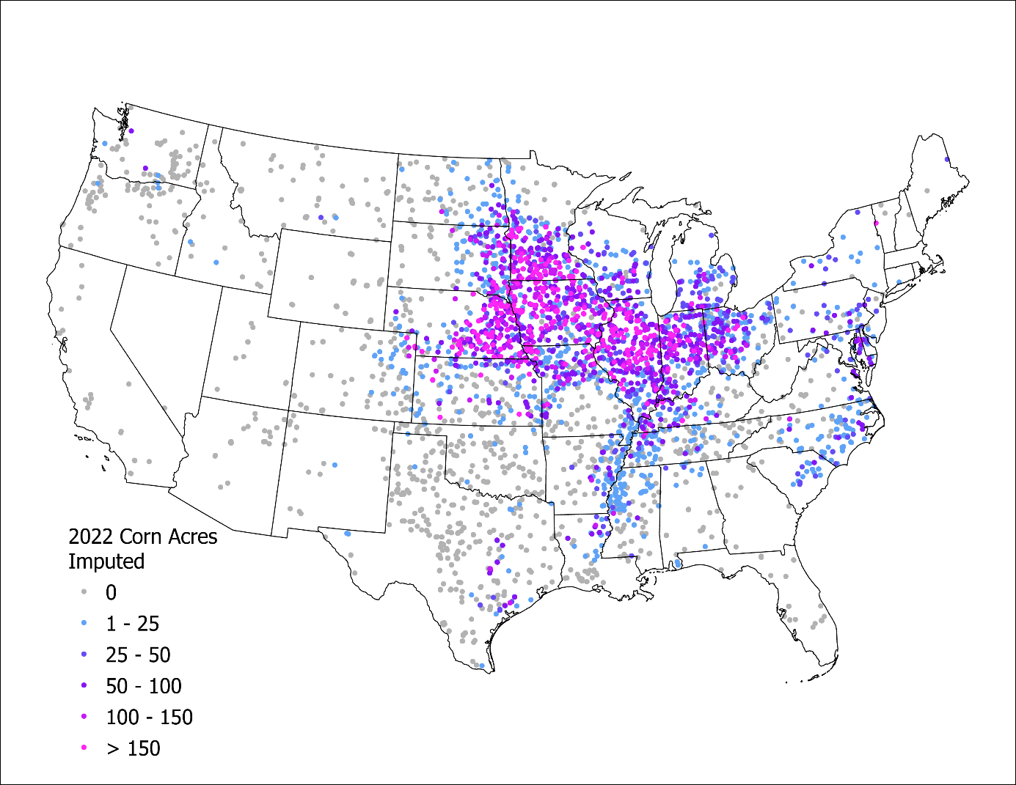
Data Availability
When using PCDL and PCSB model agreement as a selection criteria, corn acreage in approximately ¼ of the of the 2022 in-scope survey sample (7,378 tracts) was able to be automatically imputed
Geographic Distribution of Tracts to be Imputed, and their Predicted Corn Acreage
Notes:
Now, multiple historic scenarios were assessed in terms of using this model agreement approach to make tract level predictions, all with similar results. For the remainder of this presentation, we will focus on 2022 data.
In order to assess data quality, Post-season FSA signup data was used as ground truth. The farmer reported crop acreage from the FSA administrative registers were spatially linked to the digitized tracts for comparison
The graph here is used to illustrate the spatial distribution of automatic predictions that were selected via the model agreement process for corn acreage. In this case, over 7,000 tracts, representing about ¼ of the 2022 in-scope JAS sample was able to be automatically imputed.

Slide 20
Q2: State Estimate Impacts
Proportion of State Samples Automatically Imputed and the Impact on Corn Acreage Estimates (2022)
Total Imputed | 7,378 | ~25%
State | Count | Proportion
Illinois | 874 | 53%
Iowa | 758 | 47%
Minnesota | 486 | 33%
Missouri | 484 | 31%
Texas | 444 | 14%
Ohio | 443 | 44%
Nebraska | 401 | 33%
Kansas | 264 | 17%
South Dakota | 215 | 20%
Tennessee | 214 | 25%
Notes:
For the assessment of the impact to state estimates, all data in 2022, where the prediction reliability threshold was met, was replaced with the automatically imputed values, and resulting state estimates for corn acreage were compared to original corn estimate.
The graph on the left illustrates the relationship of the state acreage estimates for corn between the original corn acreage estimate (no automatic imputation) and acreage estimates with our proposed automatic imputation. Here, we see that for corn, very little impact was observed in terms of the state estimated acres.
In the table on the right, you will find the allocation of tracts across the 10 states with the highest counts of imputed data in each state.
When we put the information in both artifacts on this slide together, we can see that for some states such as Illinois, as much as half the state sample could be automatically imputed with little change to the state acreage estimates.

Slide 21
Q2: State Estimate Impacts: Change in Coefficients of Variation (CVs)
Notes:
Another important quality measure used at NASS for assessing estimates are coefficients of variation, or CVs. Here, we look at how CVs for state corn acreage estimates would have been impacted if we replaced corn acreage data with automatically imputed values where available (those 7,378 tracts).
Each bar represents the percent change in CV for the state corn acreage estimate using the automatically imputed values relative to the original corn acreage estimate.
The blue bars represent states in what we call the speculative or “spec” region. The “spec” region for corn represents the majority of the corn acreage in the country. They are sorted to be on the left part of the chart. These CVs are very minimally impacted.
The green bars represent states not in the speculative region, or “nonspec”. Overall, these are also not significantly impacted except for a few outliers. These states tend to have smaller sample sizes and corn acreage estimates that are not published at the state level.

Slide 22
Q3: Tract Level Accuracy
2022 Corn Acreage: Tract Level Performance Summarized Nationally
Root Mean Squared Error(RMSE), Mean Squared Error (MAE) and R² Compared to overlapping FSA Ground Truth
7,378 total tracts automatically imputed
 |  | Survey | Automatic Imputation
All Cases | RMSE | 32.63 | 24.47
5,582 tracts tested | MAE | 11.34 | 9.77
 | R² | 0.71 | 0.82
Reported | RMSE | 28.77 | 24.47
2,856 tracts tested | MAE | 9.04 | 9.94
 | R² | 0.77 | 0.82
Imputed/Observed | RMSE | 36.24 | 24.47
2,726 tracts tested | MAE | 13.75 | 9.59
 | R² | 0.65 | 0.81
Overall, automatic imputation more closely matches FSA data than the survey
Across US, automatic imputation more closely matches FSA data than the survey
This is even more pronounced when compared to manual imputation/
observation
This is even more pronounced when compared to manual imputation/
observation
Notes:
Here we assess tract level error using FSA Data as ground truth and comparing it to the JAS tract data for corn acreage.
Error between JAS and FSA data is measured in Root Mean Square Error, Mean Absolute Error and R^2.
We then break it out, comparing the error rates for the original survey data to error rates for data which contain automatic imputation.
When looking at the full data, the dataset that contains automatic imputed values had lower error and higher R2 for corn acreage
However, if we look at data where there were reported responses, the reported survey data performed similarly to the data containing automatic imputed values.
Most importantly, if we only look at data that was imputed in some way, the data containing automatic imputed values outperformed the manually imputed survey data for all error measures.

Slide 23
CONCLUSION
Predictive cropland data has promise for use in automatically imputing planted corn acreage reports in the JAS
Model agreement between PCDL and PCSB predictions is a useful indicator of reliable predictions
Optimizing error reduction using historic FSA data is useful for selecting tracts to automatically impute vs manually impute
Need to expand imputation method to additional land-cover types to impute the entire tract
A pilot of this method was in use for the 2024 JAS survey cycle
Notes:
In conclusion
Predictive cropland data has promise for use in automatically imputing planted corn acreage reports in the JAS
Model agreement between PCDL and PCSB predictions is a useful indicator of reliable predictions
Optimizing error reduction using historic FSA data is useful for selecting tracts to impute
We showed results for corn acreage, but this full study focused on corn/soybean/non-ag tracts. But automatic imputation is most useful if the complete tract can be imputed. So, work is underway to include more land-cover types
A pilot of the method in this paper was implemented for the 2024 JAS survey cycle and we look forward to sharing results of the implementation next year!

Slide 24
Thank You
Arthur Rosales
arthur.rosales@usda.gov
Notes:
With that, I’ll leave you with the lead author’s contact information and a big thank you for listening.

